Slide 1

How the NFL Makes Money
Presentation by Oceane, Ayoub , Jong
Notes:
In North America, there are many popular sports, but only 3 sports always came out on top
We also called it the Big Three, 3 : baseball MLB, 2:Basketball NBA, 1: NFL
Did you know the NFL generated an estimated $12 billion in revenue in 2022?
Today our topic would be about How the NFL Makes Money

Slide 2
Table of contents
Presentation (Jong)
Business model (Océane)
Future plans et challenge (Ayoub)
Conclusion
Notes:
First of all, I'm going to give you a brief presentation about NFL
Then Océane would be talk about the business model.
Ayoub would be on future plans and challenge.
And to finish a small conclusion and time for QA.

Slide 3

The Enduring Legacy of the NFL
From 1920s
Captivating gameplay, iconic players, and passionate fans
Super Bowl: cultural event beyond sports
Social impact, technological advancements, and global expansion
Notes:
The Enduring Legacy of the NFL started from its humble beginnings in the 1920s
The NFL isn't just about thrilling gameplay
It's about the fabric of American culture, captivating millions with iconic players, passionate fans,
and cultural touchstones like the Super Bowl.
The NFL's impact extends far beyond the field,
leaving its mark on society through community engagement, cultural influence, and technological advancements,
while its global expansion opens doors to new audiences and challenges.

Slide 4
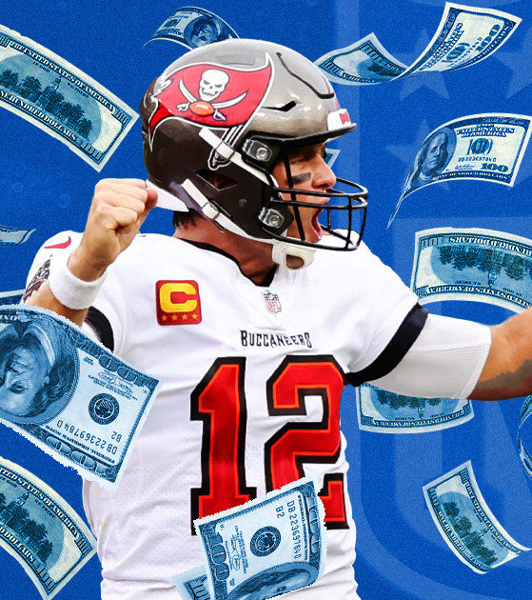
Business Model : two revenue categories
National revenue ($12 billion in 2022)
Local revenue ($6 billion in 2022)
Notes:
National revenue (+7%): This money is then divided evenly among the 32 teams regardless of individual performance.
Local revenue : This money is earned by the teams themselves.

Slide 5




Business Model : National revenue
$1.3 billion per year
$2 billion per year
TV deals
Merchandising
Licensing contracts
$2 billion per year
$2.7 billion per year
Notes:
National revenue :
TV deals : the most important revenue
Since NFL is the most-viewed sport in the USA.
Ex: In 2023, 93 of the 100 most-watched programs on television belonged to the NFL.
Therefore, not surprising to discover the most important deals in the world belong to the NFL too.
Ex : Deals with Google, Amazon, CBS, ESPN/ABC, Fox, and NBC.
Also Advertising deals :
Ex : A brand wishing to invest in a 30-second advertising spot during the SuperBowl must spend on average some $7 million.
Merchandising and licensing contracts : licensing deals bring $3 billion a year.

Slide 6




Business Model : Local revenue
Ticket sales
Concession stands
Local corporate sponsors
Notes:
Ticket sales and Concession stands : constitutes an important revenue for individual teams. One ticket is about $151. Stadiums can only renovate to add more seats and concessions stands.
Local corporate sponsors :
Corporations often like to be associated with major sports franchises and are willing to pay for the privilege.
The most coveted/ wanted sponsorships are naming rights to NFL stadiums.
Ex : The Levi's Stadium in San Francisco is a $170 million deal (from 2023 to 2043)

Slide 7
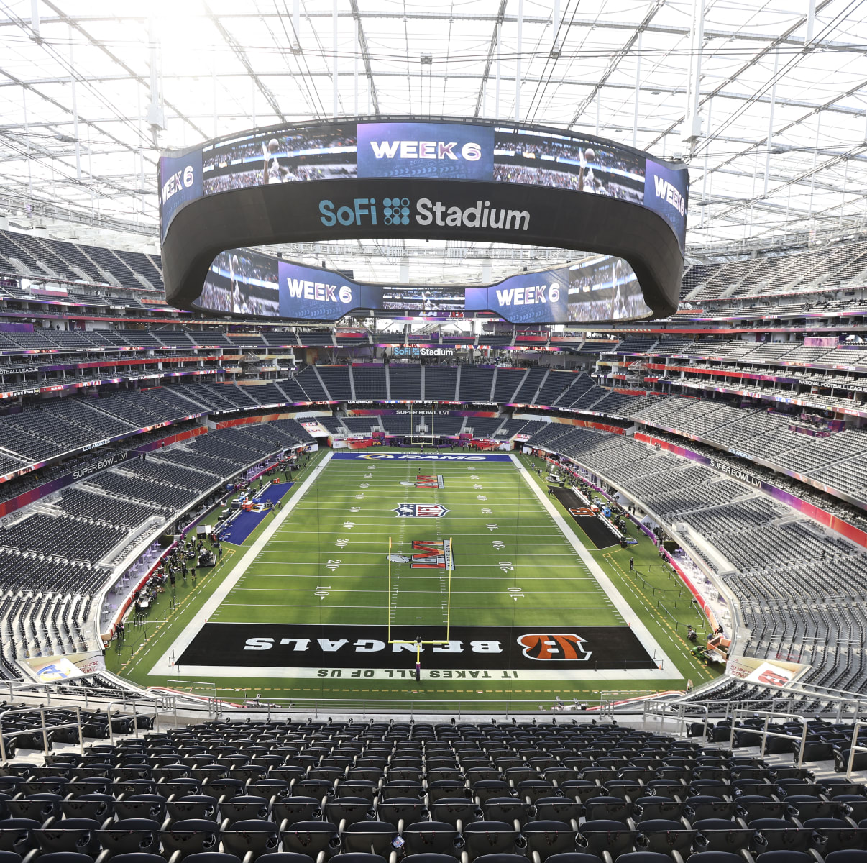
Business Model : huge revenue for important costs
Player salary (between 50 and 60%)
Stadium unkeep costs
Marketing costs
Team costs
Administrative costs
Notes:
In 2022-2023, the Packers spent $541.6 million on operating expenses. A large chunk went to pay players ($294.2 million).
the Packers reported $235.9 million in local revenue + $374.4 million from NFL (non-profit)

Slide 8
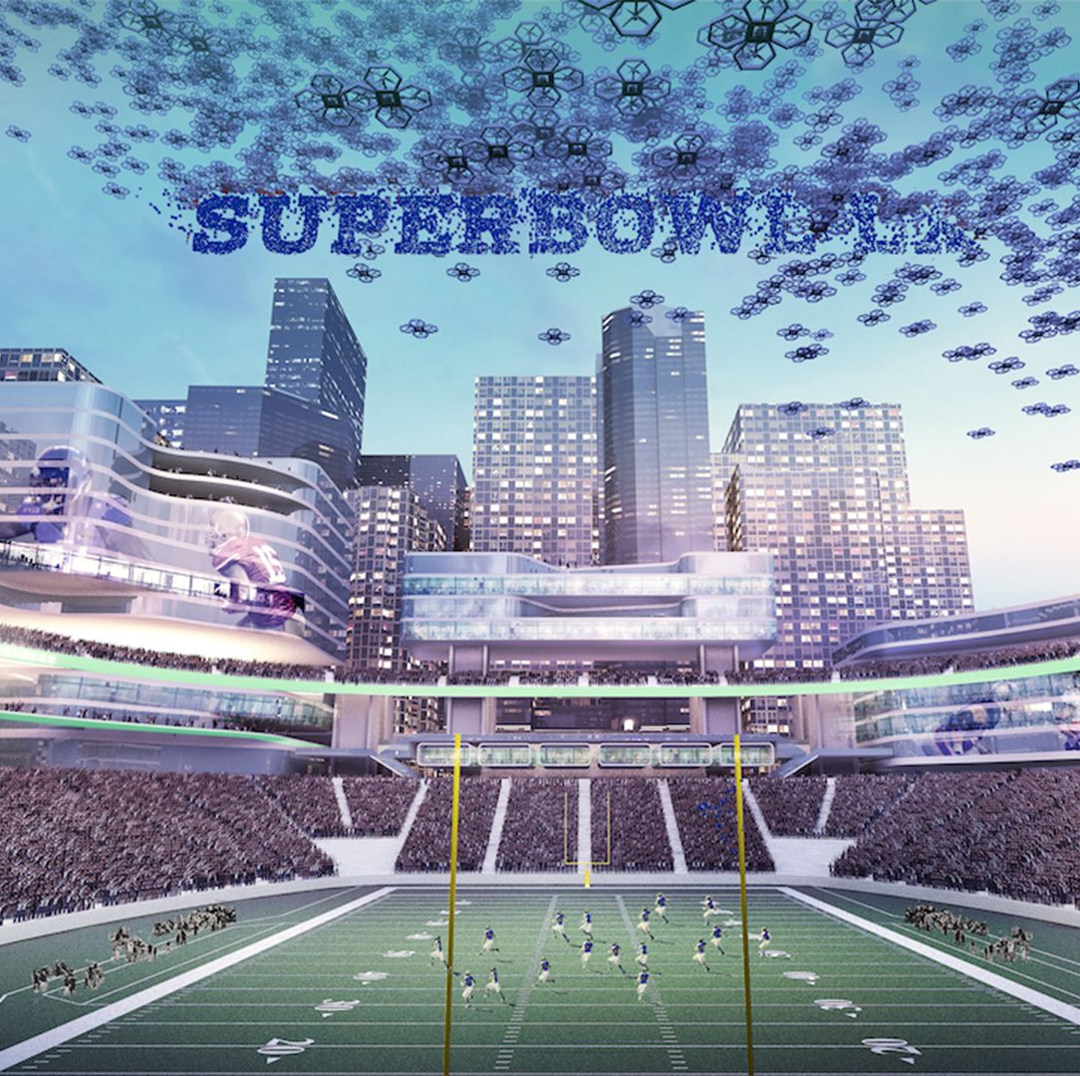
NFL's Future Plans and Growth Areas
TV and Streaming
Gambling Expansion
Notes:
Ticket sales and Concession stands : constitutes an important revenue for individual teams. One ticket is about $151. Stadiums can only renovate to add more seats and concessions stands.
Local corporate sponsors : Corporations often like to be associated with major sports franchises and are willing to pay for the privilege. The most coveted sponsorships are naming rights to NFL stadiums. Ex : The Levi's Stadium in San Francisco is a $170 million deal (from 2023 to 2043)

Slide 9

TV and Streaming
Multi-channel approach for diverse audience reach.
Long-term contracts ensure stable revenue.
Adaptability to evolving entertainment trends.
Notes:
Advertisement compaign
Multi channel

Slide 10
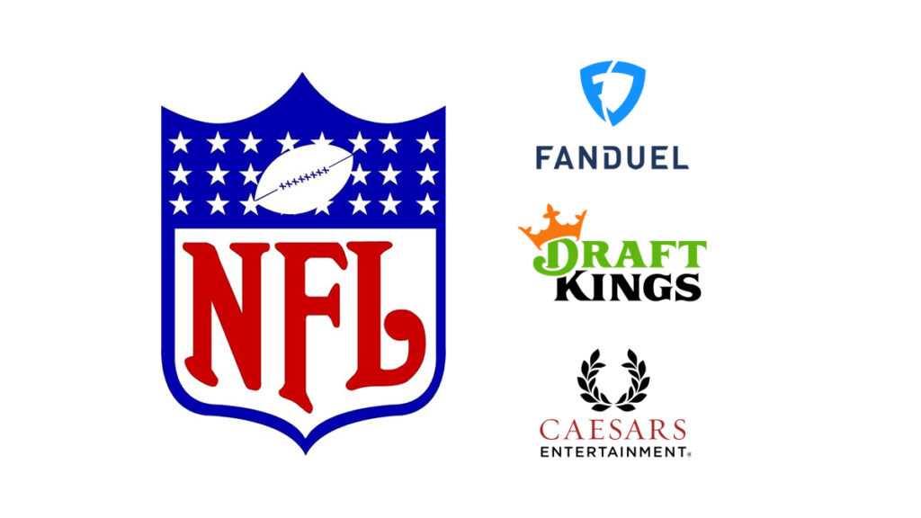

Gambling Expansion
Legalization in 38 states creates new revenue streams.
Sponsorships from Caesars, DraftKings, FanDuel.
Potential for increased engagement and advertising revenue.

Slide 11
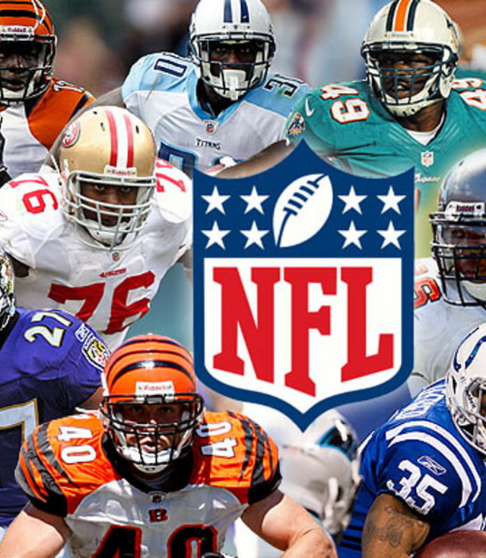
Key Challenges
Reliance on high-profile athletes poses risks.
Ongoing controversies demand careful navigation.
Strategic planning essential for sustained growth.
Notes:
1.This suggests that building a strategy solely around well-known athletes can be risky. While star athletes can bring attention and success, they also come with their own set of challenges such as potential scandals, injuries, or changes in performance.
2. This implies that the world of sports is often rife with controversies, whether it's related to athlete behavior, organizational decisions, or societal issues intersecting with sports.
3.this could mean investing in talent development, expanding into new markets, or diversifying revenue streams

Slide 12
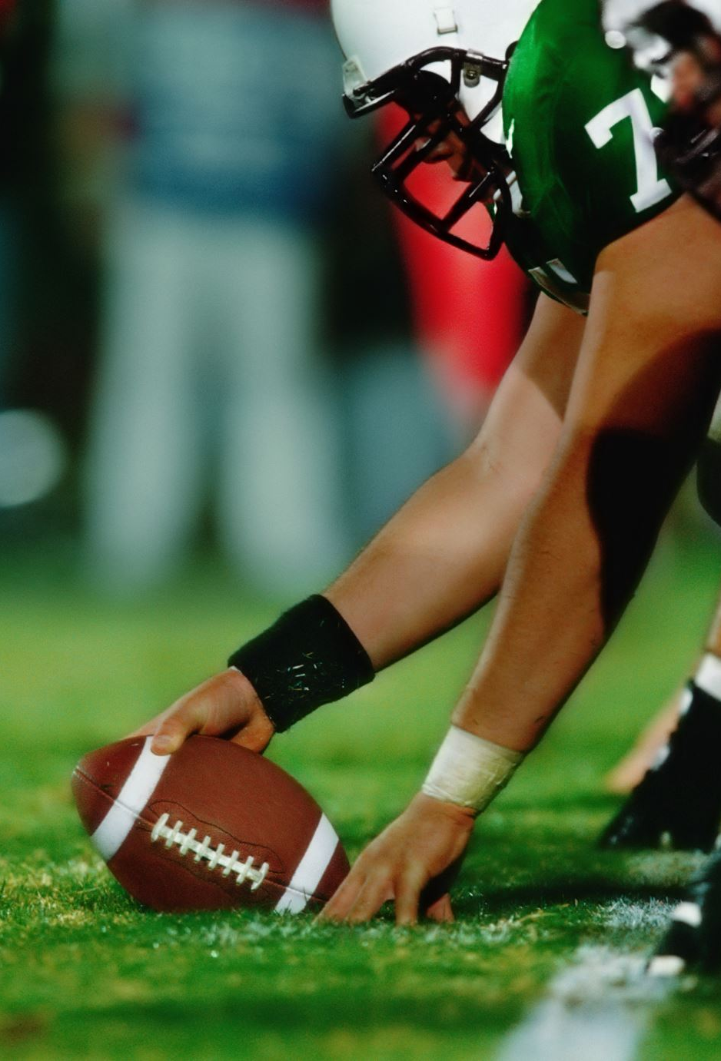
Conclusion
The National Football League (NFL) is one of the most successful sports leagues in the world.
Only one NFL team is run as a nonprofit corporation: the Green Bay Packers. The rest are privately owned.
The league gave up its tax-exempt status in 2015.
NFL Commissioner Roger Goodell has targeted $25 billion in revenue by 2027.
TV deals are the main source of revenue for the NFL, but licensing is also lucrative.
Notes:
Because of its private status, the NFL does not share its finances with the public.
TV deals is where the NFL make its most money.
Other revenue streams include ticket sales, merchandising and licensing rights, and corporate sponsorships.
Every year NFL is investing more and more, having even more spectacular show.
Therefore, it is worth asking where are the limit of their expansion

Slide 13
Sources
https://www.investopedia.com/articles/personal-finance/062515/how-nfl-makes-money.asp
https://sportsnaut.com/where-does-nfl-revenue-come-from/
https://www.forbes.com/sites/mikeozanian/2023/07/11/nfl-national-revenue-was-almost-12-billion-in-2022/?sh=49bca5d2d74b
https://polesports.hec.ca/la-nfl-un-modele-daffaires-gagnant-les-couts-2/
https://www.ecofoot.fr/nfl-puissance-economique-4902/
https://frontofficesports.com/nfl-nearing-25b-revenue-goal-and-isnt-slowing-down/
https://www.statista.com/chart/30772/sponsorship-revenue-of-major-us-sports-leagues/
https://www.cbsnews.com/news/super-bowl-2024-ticket-prices-nfl-brokers/
https://www.cbsnews.com/news/super-bowl-2024-viewership-ratings/?intcid=CNI-00-10aaa3a
https://www.packers.com/news/packers-report-another-solid-year-financially-2023

